Slide 1
Capstone Project
Indian Restaurant in New York City

Slide 2
Introduction:
Indians constitute one of the largest and fastest growing ethnicities in the New York city of the United States.
The Indian population also represents the second-largest metropolitan within the New York City.
New York City is a home to nearly 8.6 million people. Over the last decade the city has been growing faster than the region.
The New York region continues to be by far the leading metropolitan gateway for legal immigrants admitted into the United States.
People from all over India live in New York city, with diverse culture, there are many Indian restaurants in New York City, each belonging to different categories like North Indian food or south Indian and many more.

Slide 3
Business Problem:
The idea of this project is to help people to search Indian restaurant in New York city, choose the right location by providing data, rating and different cuisines.
To provide people the necessary information I'll be combining New York city data that contains list of Boroughs, Neighborhoods along with their latitude and longitude and Foursquare API

Slide 4
Data Set:
As part of this project, we will list and visualize all major parts of New York City that has great Indian restaurants.
New York City data that contains list Boroughs, Neighborhoods along with their latitude and longitude.
Data: https://cocl.us/new_york_dataset
Indian restaurants in each neighborhood of New York city.
Data: Foursquare API
GeoSpace data
Data: https://data.cityofnewyork.us/City-Government/Borough-Boundaries/tqmj-j8zm

Slide 5
Methodology:
Using Foursquare API, we will find all venues for each neighborhood.
Filter out all venues that are Indian Restaurants.
Find rating, tips and like count for each Indian Restaurants using Foursquare API.
Using rating for each restaurant, we will sort that data

Slide 6
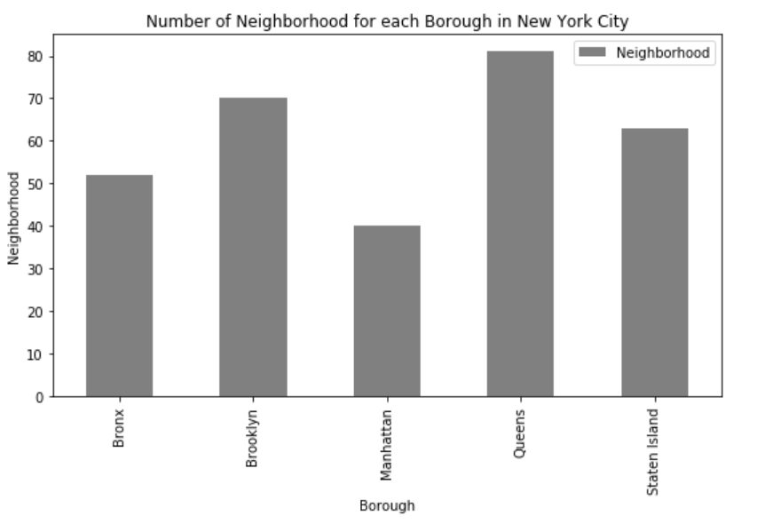
Analysis
We see that queens has highest number of neighborhoods.

Slide 7
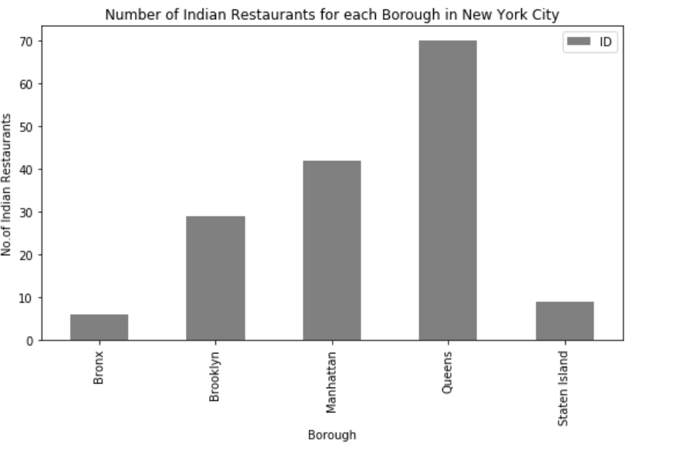
Queens has highest no of restaurants

Slide 8
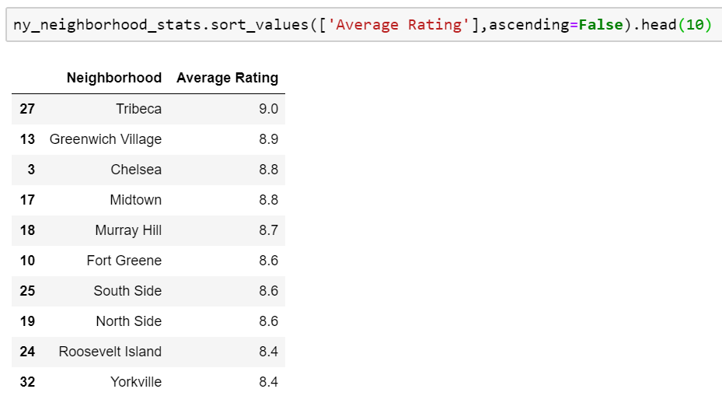
We make the decision on the average rating of the restaurants

Slide 9
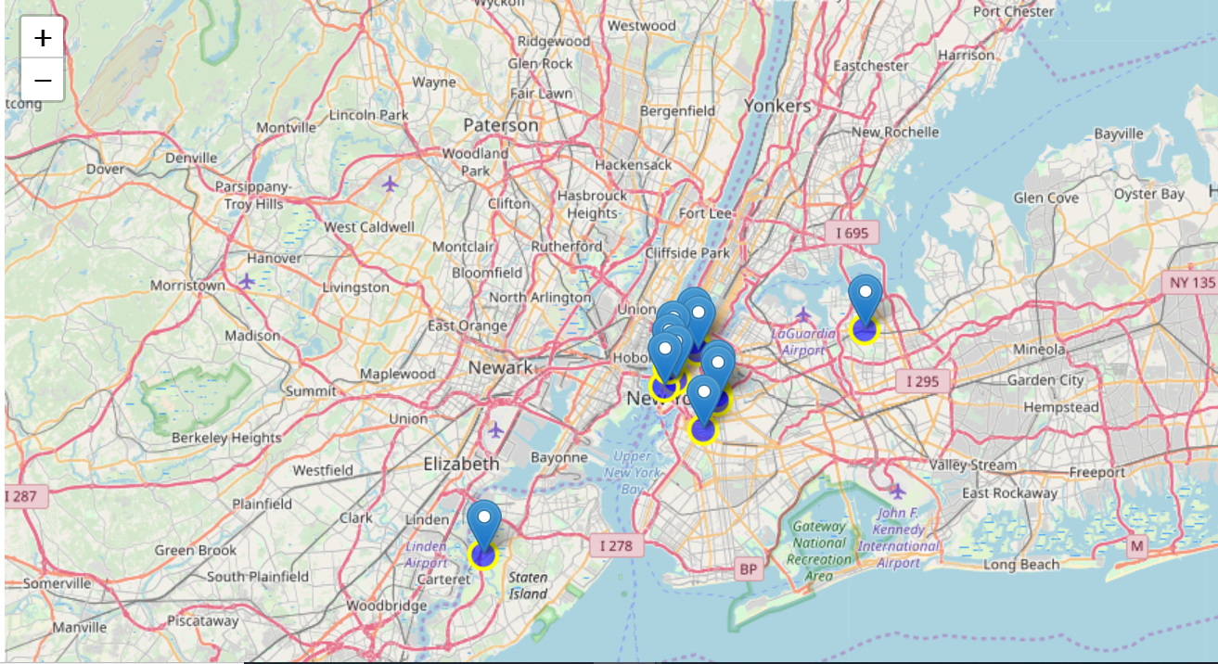
We can map the highest average rating of the restaurant

Slide 10
Conclusion:
Queens has the more no of restaurant
Manhattan has highest rating

Slide 11
Thank You

